Slide 1
Lecture 4
Correlation and Simple Linear Regression

Slide 2
Recap from last lecture
Four Main Types of Data
Quantitative (Discrete and Continuous)
Qualitative (Nominal and Ordinal)
Visualizing Data
Histograms, Histogram vs. Bar Chart, Scatter Plots
Discussed some introductory statistics about center and spread
Mean, Median
Skewness
Standard Deviation
Standard Units

Slide 3

Plotting and Pandas!
(Demo)

Slide 4
Correlation
Intuition: We want to be able to measure how linearly related two quantitative variables are
“Linear Relationship” - If I increase x by some amount, y will always change by the same amount. The approximate slope of the data is constant
y = mx + b

Slide 5
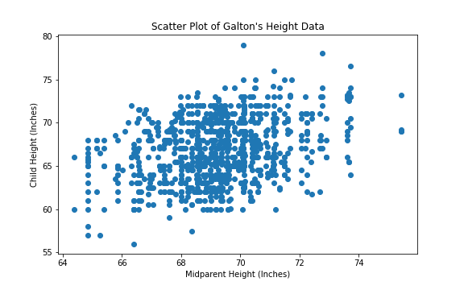
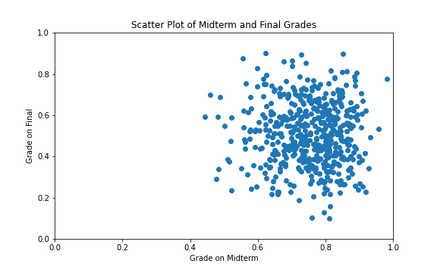
Correlation
Real world data never fits perfectly with a straight line

Slide 6
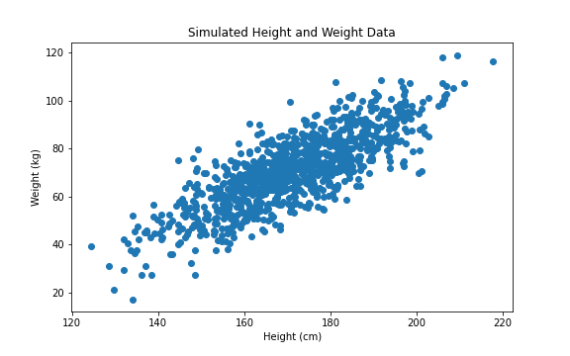
Correlation
However, some data is more “linear” or “line like” than others

Slide 7
Correlation
We want to be able to quantify this relationship - how are we able to give these things a number, so that we can rank how related these variables are?
Least “Line Like”
Most “Line Like”

Slide 8
Correlation
Let’s first define some terms:
Positive association:
Increasing one variable, causes the other variable to increase as well
“Positively Correlated”

Slide 9
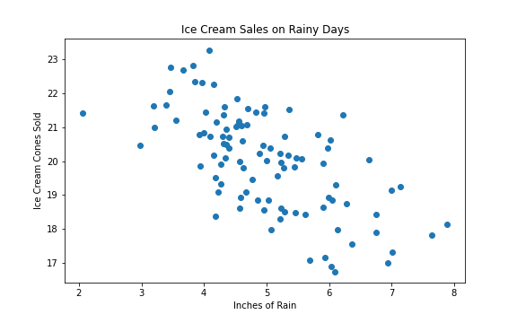
Correlation
Negative association:
Increasing one variable, causes the other variable to decrease
“Negatively Correlated”

Slide 10
Correlation
No association:
Can’t really tell if increasing the variable is causing it to increase or decrease
“No Correlation”

Slide 11
The Correlation Coefficient - r
Measures the linear association between two units
Based on Standard Units
Bounded between -1 and 1, which captures the concepts on the previous slide
If 0 < r ≤ 1 : Positive correlation
If -1 ≥ r > 0 : Negative correlation
If r = 0 : No correlation

Slide 12
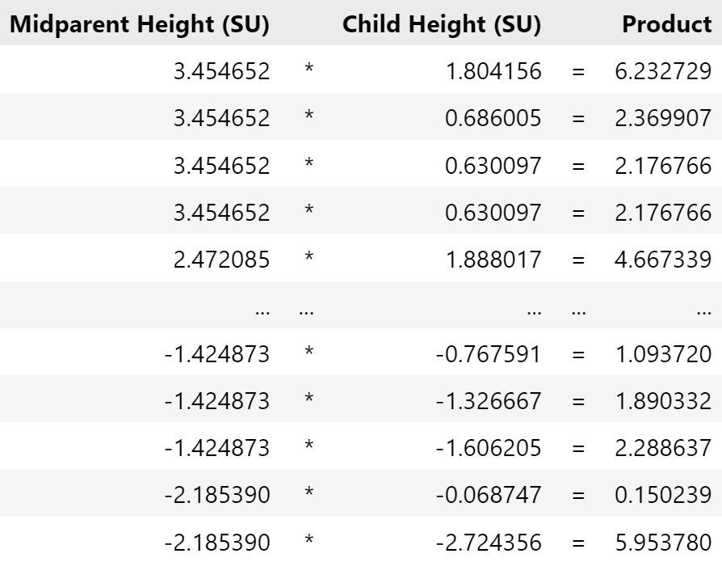
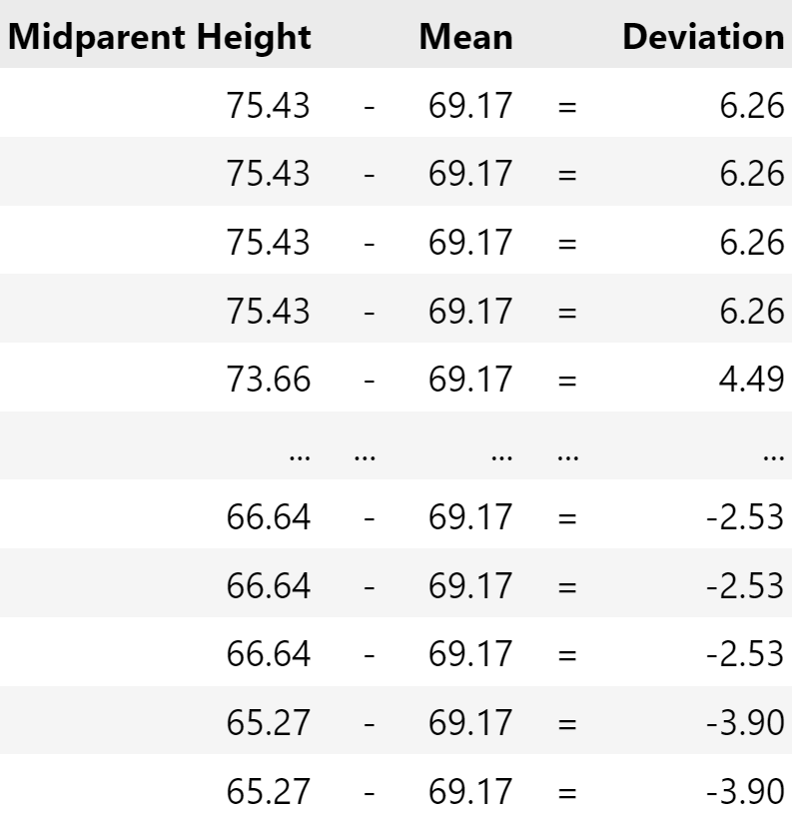
Definition of r
Average of the product of X in standard units and Y in standard units
Standard Units (z):
z = (Value - Average)/SD
SD from last lecture
r = 0.32
÷ 1.8018

Slide 13
Quick Check In
Correlation: 0.32
Defined a measurement of how linear two variables are with each other
Correlation
Calculated it for the Galton Height Data

Slide 14
Quick Exercise (website)
Test what you feel about correlation - intuitive understanding

Slide 15
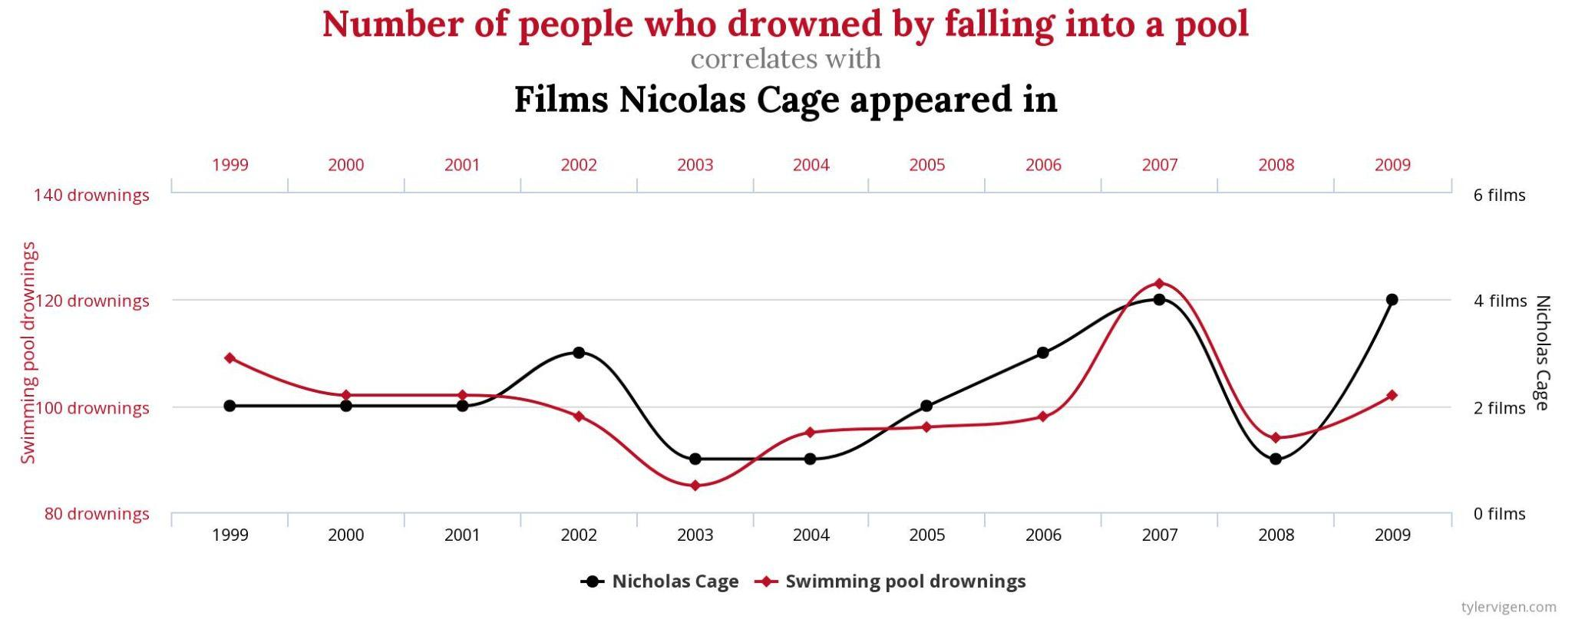
Cautionary Message
Just because we have this measure of linear association - this does not mean one causes the other, just that things have this relationship between them
High correlation is good because there is a pattern, but don’t over interpret it

Slide 16
Linear Regression
Once we have the correlation coefficient, we know something about the relationship between the two variables
If we are given a new midparental height, how might you predict their child’s height?
Thoughts?

Slide 17
Linear Regression
Biggest problem with predicting:
There isn’t one child height for each midparental height - what height for their child should you pick?
Maybe we can take averages?

Slide 18
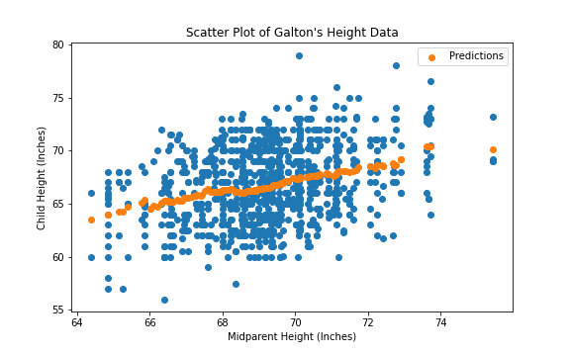
Predicting Heights 1.0
Bin the heights, find the average of each bin, and use that as the prediction

Slide 19
Predicting Heights 1.0
Pros and Cons of using this method?
On average you will be correct
Lot of data to store - might be kind of cumbersome
What if you want to predict something that hasn’t already been observed? Outliers?
How to remedy
Since we know that the data is approximately linear, let’s just make some equation to approximate the data and call it a day!
When we want to make predictions - all we need is some simple math
y = mx + b predicted_child_height = m * midparent_height + b

Slide 20
Predicting Heights 2.0
Which line though? What are the values of m and b - the slope and the intercept?

Slide 21
How to find the best line
One way - “numerical” - keep guessing and checking until you have a “good” line - how do we define good?
Another way - “analytical” - use what we know about the relationship between the two variables to just figure out what the line is through math

Slide 22
RMSE
Remember - our goal is to find a line that is good at approximating the data

Slide 23
RMSE
When we predict, we just plug in the Midparent Height into our equation and it will return our predicted child height: predicted_y = m*x + b
No line will be able to predict every point perfectly, but some lines clearly predict closer to points than others
We want to somehow minimize the amount of “error” that our line makes in our predictions
Notes:
Consider the yellow point that I’ve highlighted - let’s think about what each line will make as a prediction - it will be the corresponding lines on that vertical area, correct?

Slide 24
RMSE
Our line makes errors for every point - but we want to make this the smallest possible
Can we just add up all the errors together and then try to make that as small as possible?
No! Some estimates will overestimate while others will underestimate
Adding these together will cancel them out, which we don’t want!
Possible solutions?
Squaring all the errors
Then we take the mean again
And then square root it
Root Mean Squared Error

Slide 25
RMSE
Sounds very similar to how we calculated Standard Deviation
Instead of considering how far away on average are we from the mean
Now we are considering how far away on average are we from the truth

Slide 26
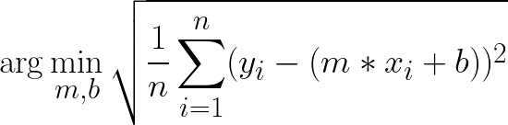
RMSE
This is also known as “Least Squares” - minimizing the squared error
Computers do most of this work for us but the problem looks like this:
Find the m and b that makes this quantity the smallest:

Slide 27
RMSE
Square Root it All
Squared Error
Prediction
Average Squared Error
Error

Slide 28
Analytical Solution
We know the correlation between the two variables, which gives us information about the two variables in standard units
When x and y are both in standard units, the regression line has slope r and passes through the origin. In other words,
estimate of y = r * x when both variables are measured in standard units

Slide 29

Analytical Solution
(Estimate of y in standard units) = r * (x in standard units)
We know all of these numbers except for the estimate of y!
So we can solve for the estimate!

Slide 30
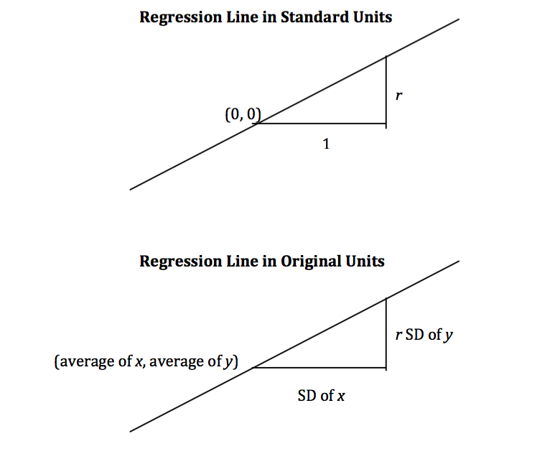
Analytical Solution

